Slide 1
Projet <DCAS-14> Improving Human-Robot Interactions with Deep Reinforcement Learning
Alois BLARRE, Felipe SILVA
Supervisors:
Caroline CHANEL
Nicolas DROUGARD

Slide 2
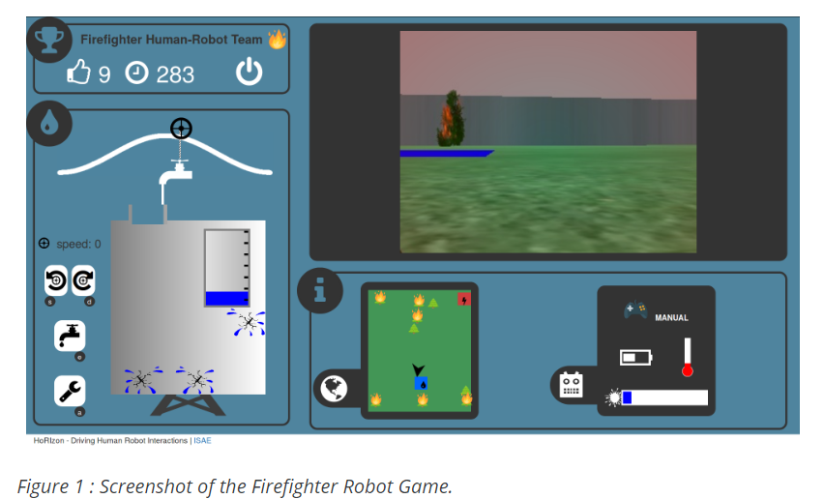


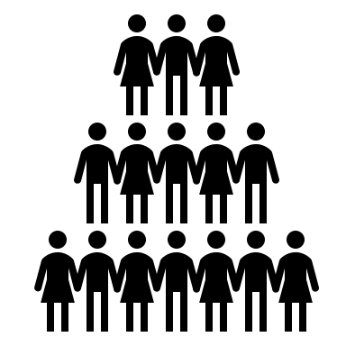
Context
To pursue the study of the interaction of human and automated systems a huge amount of data is necessary

Slide 3


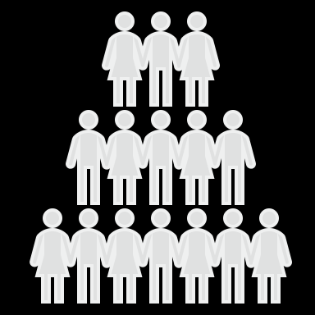
Context
To pursue the study of the interaction of human and automated systems a huge amount of data is necessary

Slide 4
Context
To pursue the study of the interaction of human and automated systems a huge amount of data is necessary

Slide 5
Context
To pursue the study of the interaction of human and automated systems a huge amount of data is necessary

Slide 6
Problem statement
Can recent deep learning algorithms be used to generate artificial results of simulations ?

Slide 7
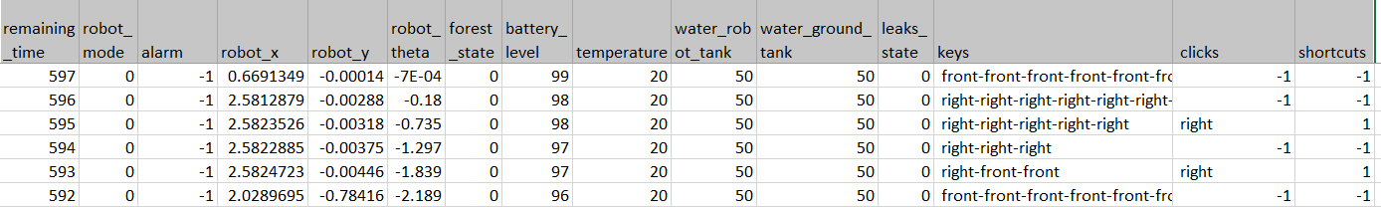
Problem statement

Slide 8
Problem statement

Slide 9
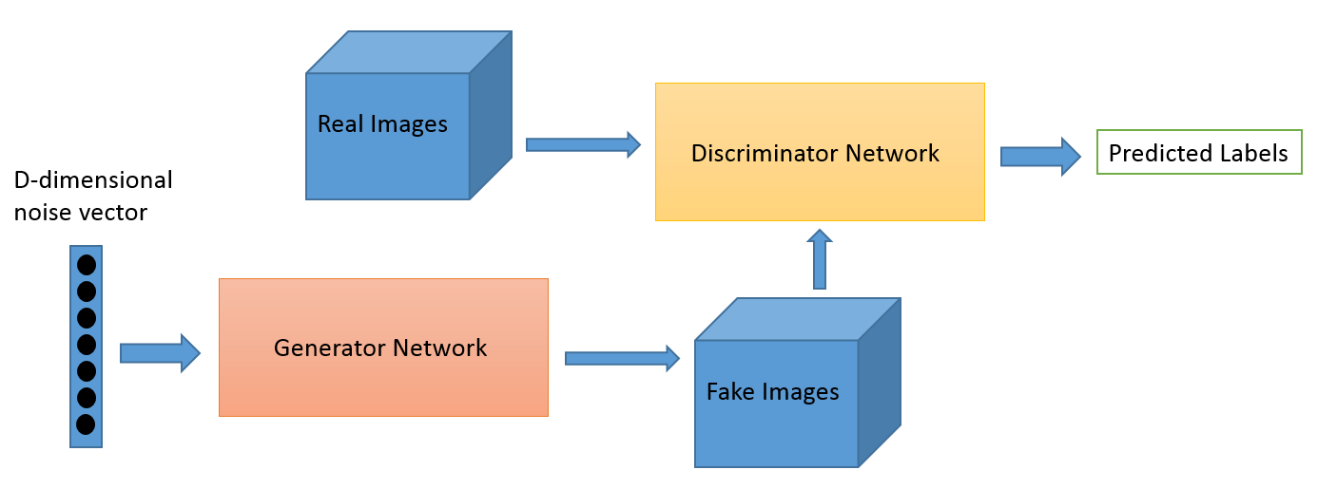
State-of-the-art
GAN
CONV NET

Slide 10
State-of-the-art
GAN
CONV NET

Slide 11
Phase 1: DATA TREATMENT
Treat the data

Slide 12
Phase 1: DATA TREATMENT
Treat the data
Divide the dataset : movements of the robot

Slide 13
Phase 1: DATA TREATMENT
Treat the data
Divide the dataset :movements of the robot
Simplify

Slide 14
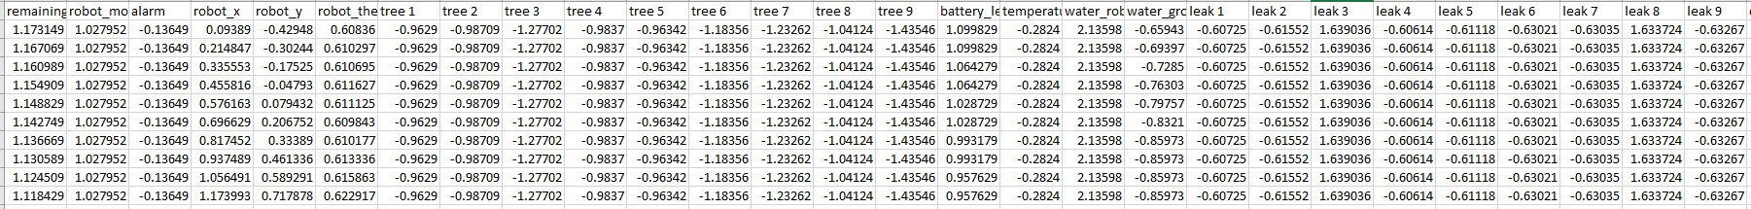
Phase 1: DATA TREATMENT

Slide 15
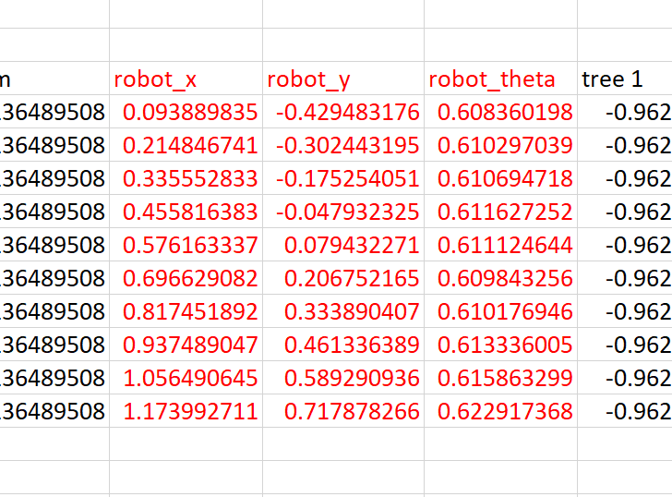
Phase 1: DATA TREATMENT

Slide 16
Phase 1: DATA TREATMENT
14 653 files

Slide 17
1st approach
Generate user’s input
n+1
Advancement
Direction
n

Slide 18
1st approach
Situation
DCGAN’s architecture
Direction
Advancement
+
Generator
Situation
+
Direction
Advancement
Discriminator
Random
+
Situation

Slide 19
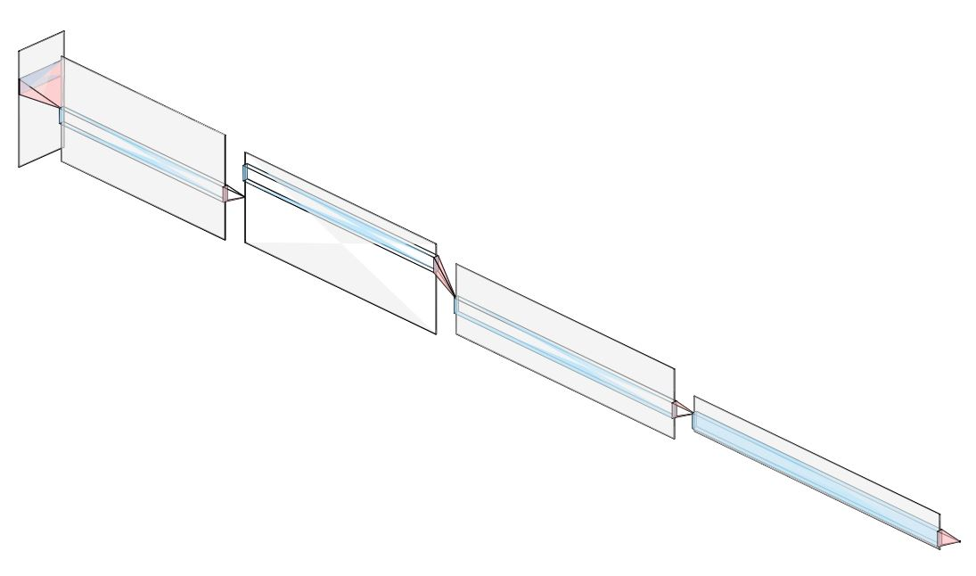
Phase 2: IMPLEMENTATION
Discriminator’s architecture

Slide 20
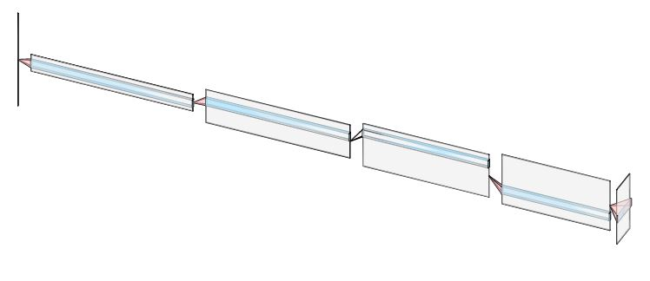
Phase 2: IMPLEMENTATION
Generator’s architecture

Slide 21
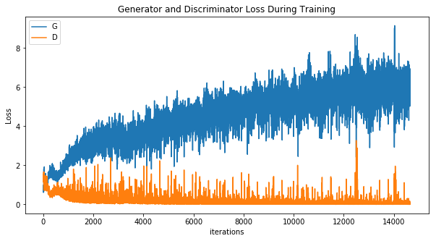
Phase 3: VALIDATION
Convergence

Slide 22
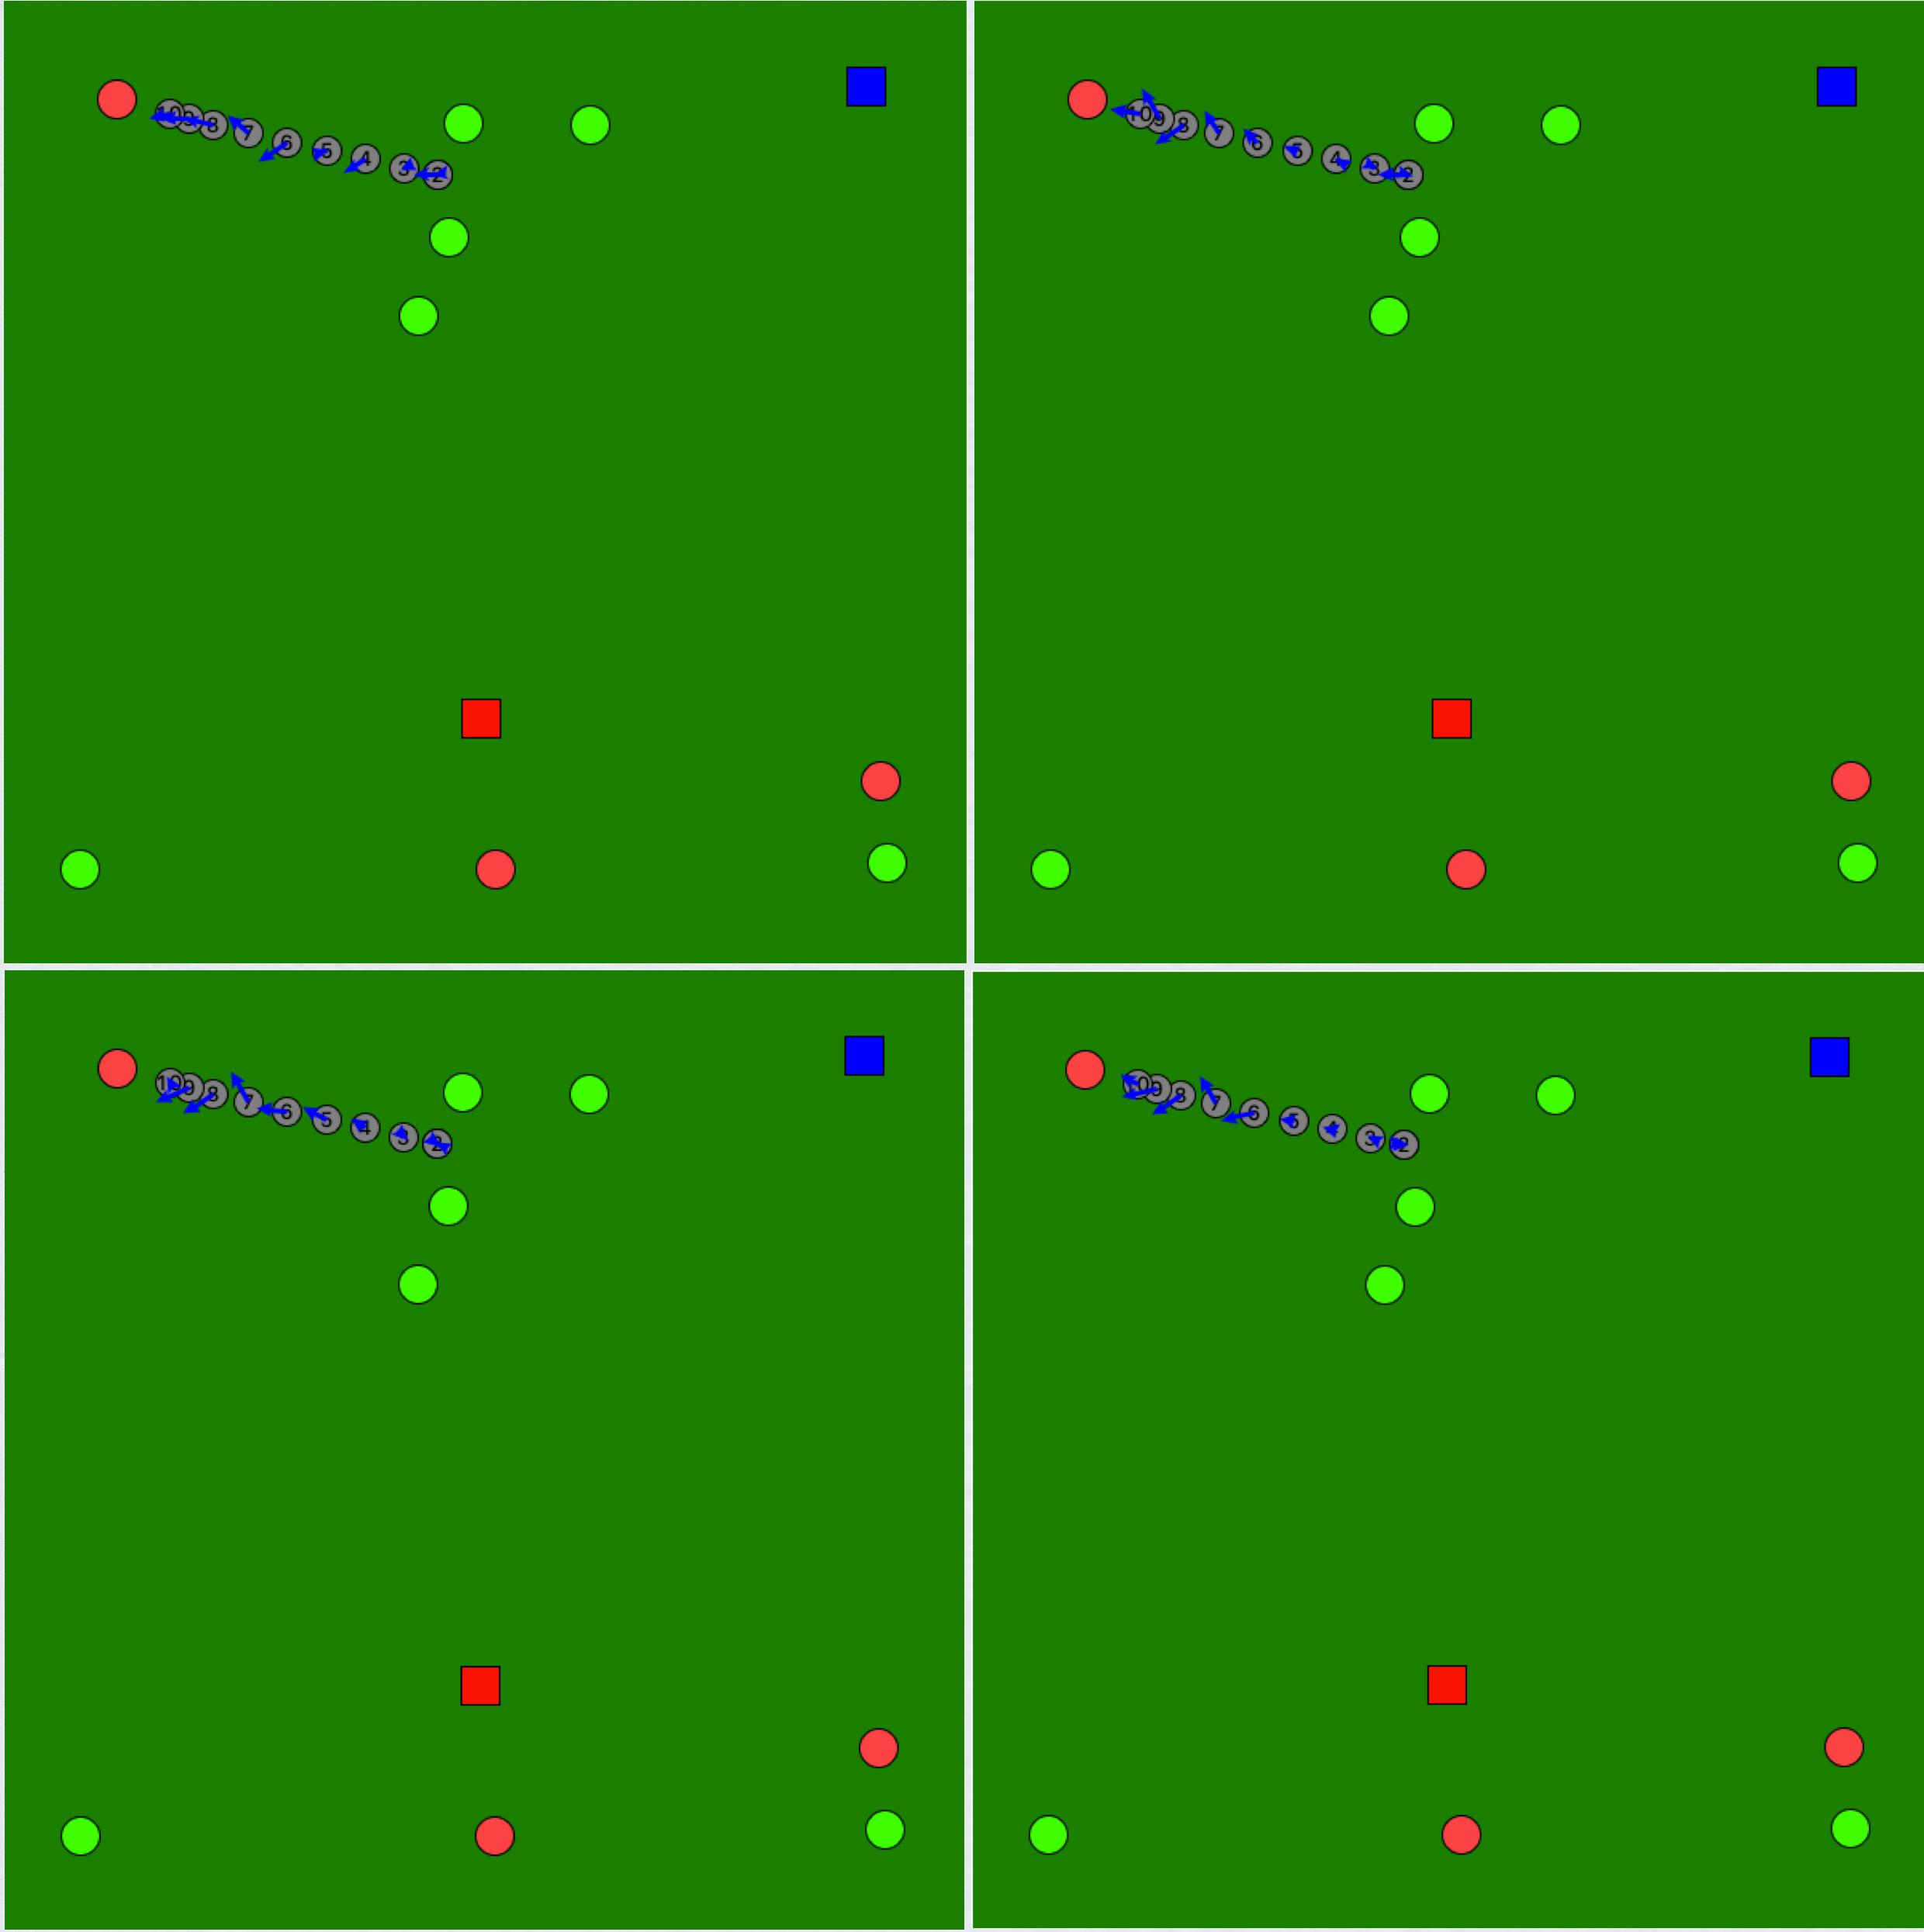
Phase 3: VALIDATION
Visual validation
Evolution of the results throughout the epochs

Slide 23
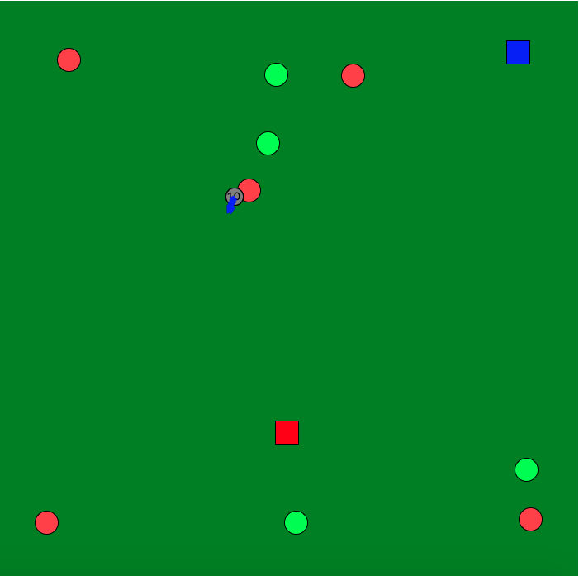
Phase 3: VALIDATION
Visual validation
1st approach results

Slide 24
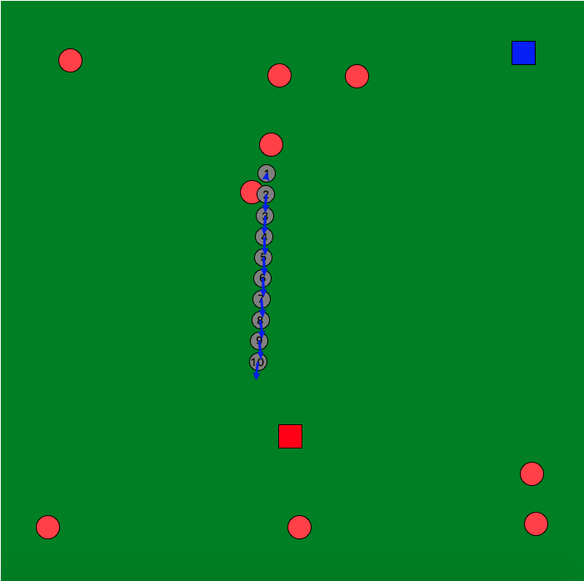
Phase 3: VALIDATION
Visual validation
1st approach results

Slide 25
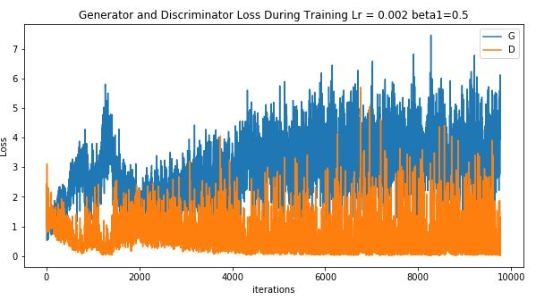
Results

Slide 26
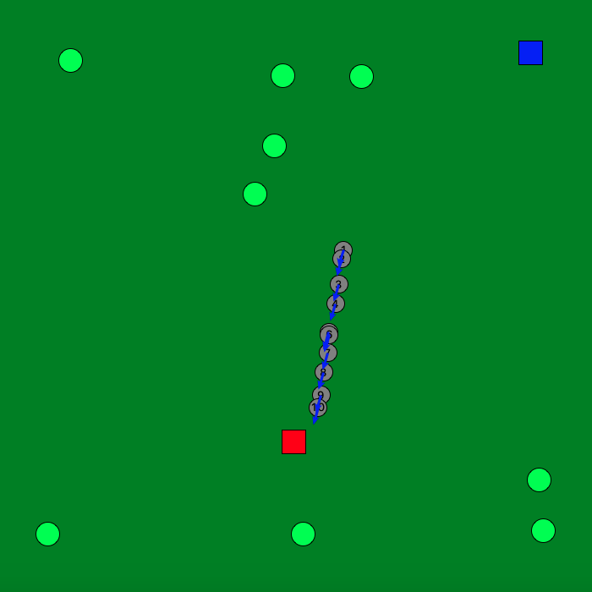
Results

Slide 27
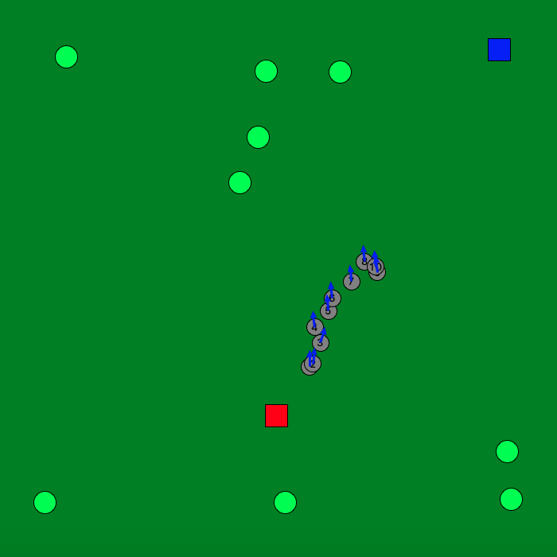
Results

Slide 28
Many thanks! Questions?

